Slide 1
Food Order Report
Ashma Gurung

Slide 2

OBJECTIVE
The food aggregator company has stored the data of the different orders made by the registered customers in their online portal. They want to analyze the data to get a fair idea about the demand of different restaurants which will help them in enhancing their customer experience.

Slide 3
Findings
Weekday vs Weekend
Popular restaurant
Popular Cuisine Type
Number of restaurants by Cuisine Type
Most popular cuisine on Weekend and Weekday
Average rating by Cuisine Type
Average delivery time
Average Cost by Cuisine Type

Slide 4
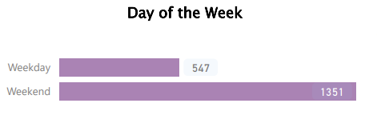
Weekday Vs Weekend
Weekend has more orders compared to Weekday

Slide 5
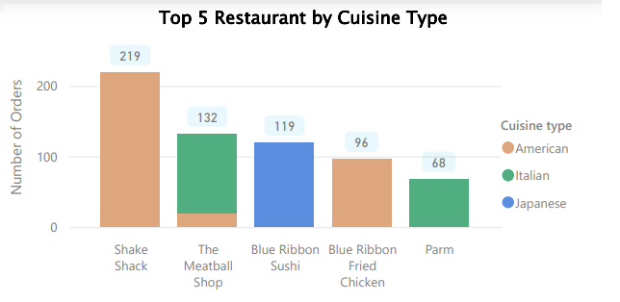
Popular restaurant
American, Italian and Japanese are the most popular restaurants

Slide 6
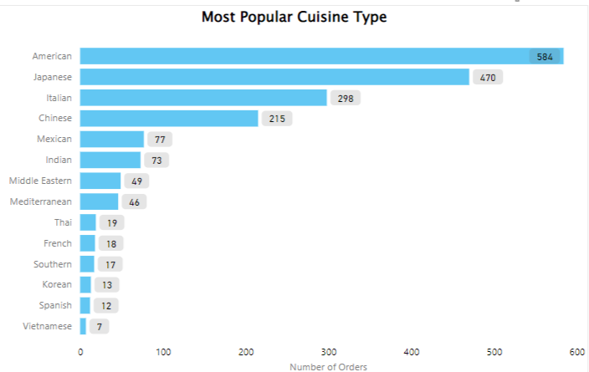
Popular Cuisine Type
American is the most popular cuisine with 584 orders while Vietnamese cuisine is the least popular with 7 orders

Slide 7
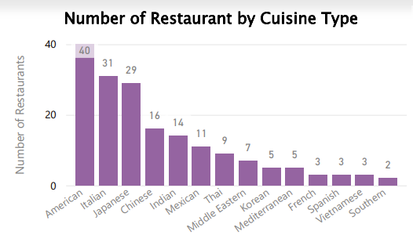
Number of restaurants by Cuisine Type
American has the highest number of restaurants at 40 followed by Italian and Japanese
Southern has the lowest number of restaurants

Slide 8
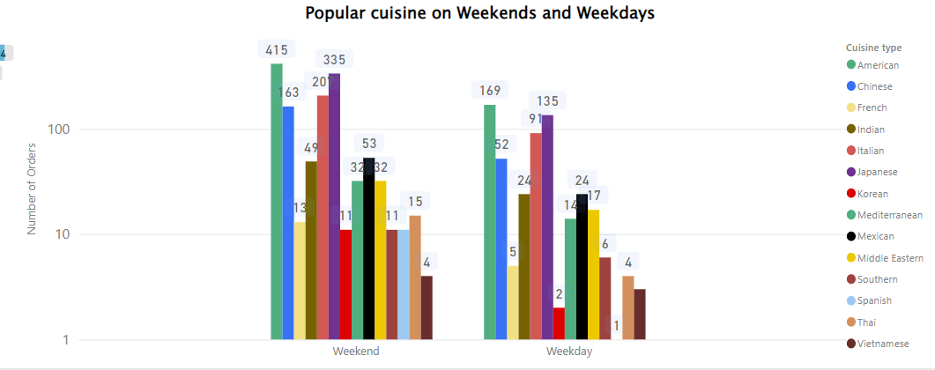
Most popular cuisine on Weekend and Weekday
American is the most popular cuisine both on weekdays and weekends followed by Japanese and Italian

Slide 9
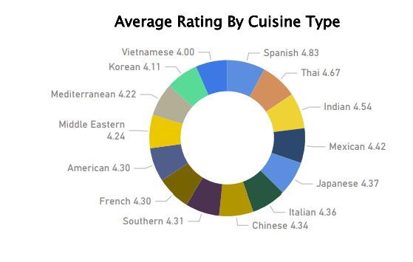
Average rating of Cuisine Type
Spanish, Thai, and Indian cuisine are the top 3 highest overall rated cuisine

Slide 10
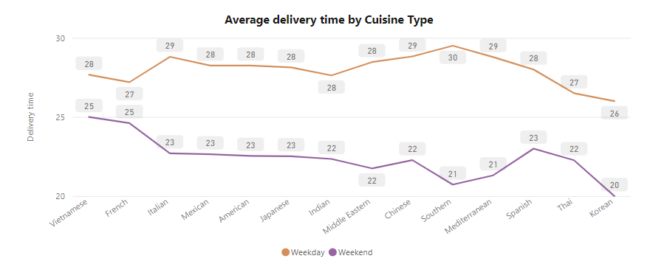
Average delivery time
Delivery time on weekends is better than weekdays
Korean average delivery time is 6 minutes longer on weekdays compared to the weekend

Slide 11
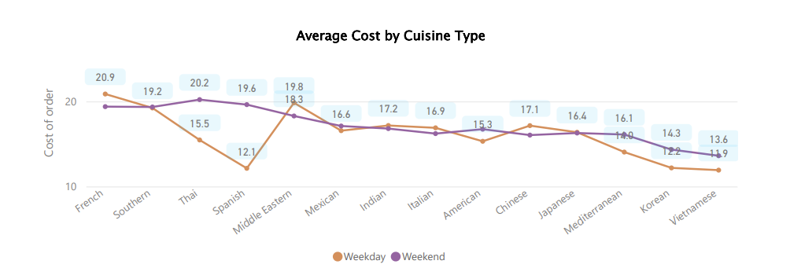
Average Cost by Cuisine Type
Korean and Vietnamese are the cheapest cuisine
French cuisine is the most expensive on average
On average people spend more on weekend than on a weekday

Slide 12
Summary
Weekend is busier than Weekday
American, Japanese and Italian cuisine are the most preferred cuisine
Spanish, Thai, and Indian are the highest-rated cuisine
American has the highest number of restaurants followed by Italian and Japanese

Slide 13
Recommendations
Add more Spanish, Thai, Indian, and Mexican restaurants as they are the highest-rated cuisine
Out of 1898 orders, 39% did not give a rating so more data on that is needed

